Slide 1

Introduction to algorithms functional programming – recursion
Lecture III
14 October 2021

Slide 2
This lecture is very important!!
Fundamental concepts in functional programming will be introduced.
RECURSION
RECURSIVE PROCEDURES
Recursive programming is the main theme in this module!!

Slide 3
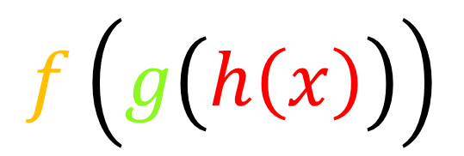
Simple representation of Functional programming
X=k(a,b,c)
[main]
Y=f(a,b)
Z=g(a,b)
W=h(a,b,c)
…
…
…
…
…
…
…
…
…
…
Return X
…
…
…
…
…
Return Y
…
…
…
…
…
Return Z
…
…
…
…
…
Return W
function
calls
W=h(a,b,c)
Y=f(a,b)
[subroutines (functions)]
calling functions inside another function
Z=g(a,b)
$$f\left(g\left(h\left(x\right)\right)\right)$$

Slide 4
Example – find minimum of three numbers
Algorithm: min3(x,y,z)
Requires: three numbers; x, y and z
Returns: the smallest of x, y, z
1. if (x<y) && (y<z) then
2. return x
3. elseif (y<x) && (x<z) then
4. return y
5. else
6. return z
7. endif
8. end

Slide 5
Example – find minimum of three numbers (functional)
Algorithm: min3(x,y,z)
Requires: three numbers; x, y and z
Returns: the smallest of x, y, z
Algorithm: min(x,y)
Requires: two numbers; x, y
Returns: the smallest of x, y
main
subroutine
1. return min(min(x,y),z)
2. end
1. if (x<y) then
2. return x
3. else
4. return y
5. endif
6. end
Let’s Trace it!
x=2, y=0, z=-2
min3(2,0,-2):
min(min(2,0),-2)
0
min(0,-2)
-2

Slide 6
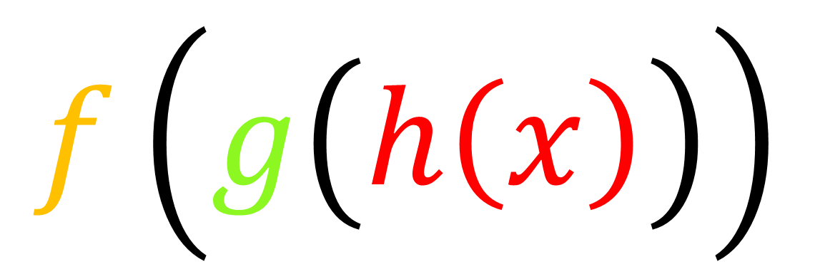
Calling function inside itself
$$f\left(g\left(h\left(x\right)\right)\right)$$

Slide 7

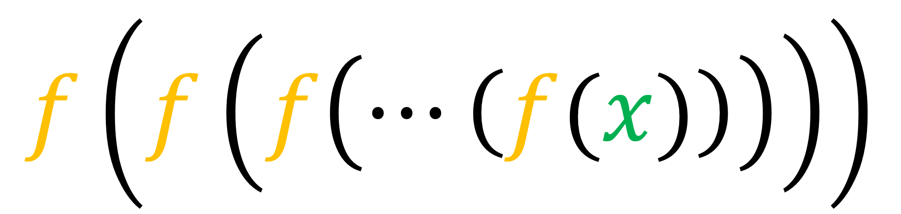

Calling function inside itself
$$f\left(f\left(f\left(⋯\left(f(x)\right)\right)\right)\right)$$
RECURSIVE
PROGRAMMING
$n$ times
RECURSION
$$(n≠∞)$$

Slide 8

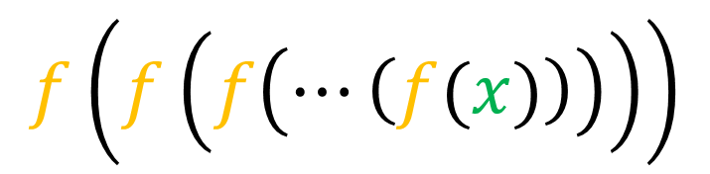

Recursion/recursive procedure
go back and repeat
Repeat?
How many times??
$$f\left(f\left(f\left(⋯\left(f(x)\right)\right)\right)\right)$$
$n$ times
$$(n≠∞)$$

Slide 9
Recursion/recursive procedure
go back and repeat
Repeat?
How many times??
Recursion MSUT STOP at some point!
some point!?
base case

Slide 10
Recursion anatomy
Y=F(X)
Let X=X_{i} \\ intitialise
if base_case == TRUE then
return base_value
stop
else
update X_{i}
return F(X_{i})\\ recursive call
endif
Go back and repeat
[F(X_{i})=Y_{base}]

Slide 11
Recursion anatomy
Y=F(X)
Let X=X_{i} \\ intitialise
if base_case == TRUE then
return base_value
stop
else
update X_{i}
return F(X_{i})\\ recursive call
endif
Go back and repeat
[F(X_{i})=Y_{base}]

Slide 12
Recursion anatomy
Y=F(X)
Let X=X_{i} \\ intitialise
if base_case == TRUE then
return base_value
stop
Call No.3
[F(X_{i})=Y_{base}]
evaluate
Call No.1
Call No.2
Y=F(X)
Let X=X_{i} \\ intitialise
if base_case == TRUE then
return base_value
stop
else
update X_{i}
return F(X_{i})\\ recursive call
endif
Y=F(X)
Let X=X_{i} \\ intitialise
if base_case == TRUE then
return base_value
stop
else
update X_{i}
return F(X_{i})\\ recursive call
endif
Call No.3
Return Y_{base}
Call No.2
Return F(Y_{base})
Call No.1
Return F(F(Y_{base}))
call

Slide 13

Factorial example - $\left(n!\right)$
We want to write an algorithm that computes the factorial of a given non-negative integer number n.
The factorial of n is
n × (n -1) × (n -2) × ... × 2 × 1
The factorial of 0 is 1

Slide 14

Factorial example- $\left(n!\right)$
factorial(0) = 1
factorial(1) = 1
factorial(2) = 2 X 1
factorial(3) = 3 X 2 X 1
factorial(4) = 4 X 3 X 2 X 1
factorial(5) = 5 X 4 X 3 X 2 X 1
1
1 X factorial(0)
2 X factorial(1) = 2 X 1
3 X factorial(2) = 3 X 2 X 1
4 X factorial(3) = 4 X 3 X 2 X 1
5 X factorial(4) = 5 X 4 X 3 X 2 X 1
.
.
.
factorial(4)

Slide 15
Factorial example- $\left(n!\right)$
factorial(0) =
factorial(1) =
factorial(2) =
factorial(3) =
factorial(4) =
factorial(5) =
1
Need a base case!!
1 × factorial(0)
2 × factorial(1)
factorial(n) =
n x factorial(n-1)
3 × factorial(2)
4 × factorial(3)
Recursive formula
5 × factorial(4)
.
.
.

Slide 16

Let’s write the Algorithm for $n!$
Algorithm: factorial(n)
Requires: a non-negative integer n>=0
Returns: the factorial of n
comments
1. if n==0 then
2. return 1 \\ base case
3. else
4. return n*factorial(n-1) \\ recursive formula
5. endif
6. end

Slide 17
Trace!!
Algorithm: factorial(n)
Requires: a non-negative integer n>=0
Returns: the factorial of n
factorial(5)
Check base case
n=5
n != 0
return 5*factorial(4)
=5x24=120
1. if n==0 then
2. return 1 \\ base case
3. else
4. return n*factorial(n-1)\\ recursive formula
5. endif
6. end
n=4
n != 0
return 4*factorial(3)
=4x6=24
n=3
n != 0
return 3*factorial(2)
=3x2=6
n=2
n != 0
return 2*factorial(1)
=2x1=2
n=1
n != 0
return 1*factorial(0)
=1x1=1
base case
n=0
n == 0
return 1
STOP
Computation

Slide 18
summary
Components of a recursive algorithm
base case
Recursive formula should approach base case
Recursive formula

